Slide 2
仪表参数：
Density=-158.7
IQoffset=0.0045
Gain Imb=0.002
PhaseNoise=[100 -98.57 1e3 -107.56 1e4 -121.67]
DAC_Nbits=14
Imp 测试参数：
Density=-158.7
IQoffset=0.045
Gain Imb=0.02
PhaseNoise=[100 -88.57 1e3 -97.56 1e4 -111.67]
DAC_Nbits=12
TOIout=20

Slide 3
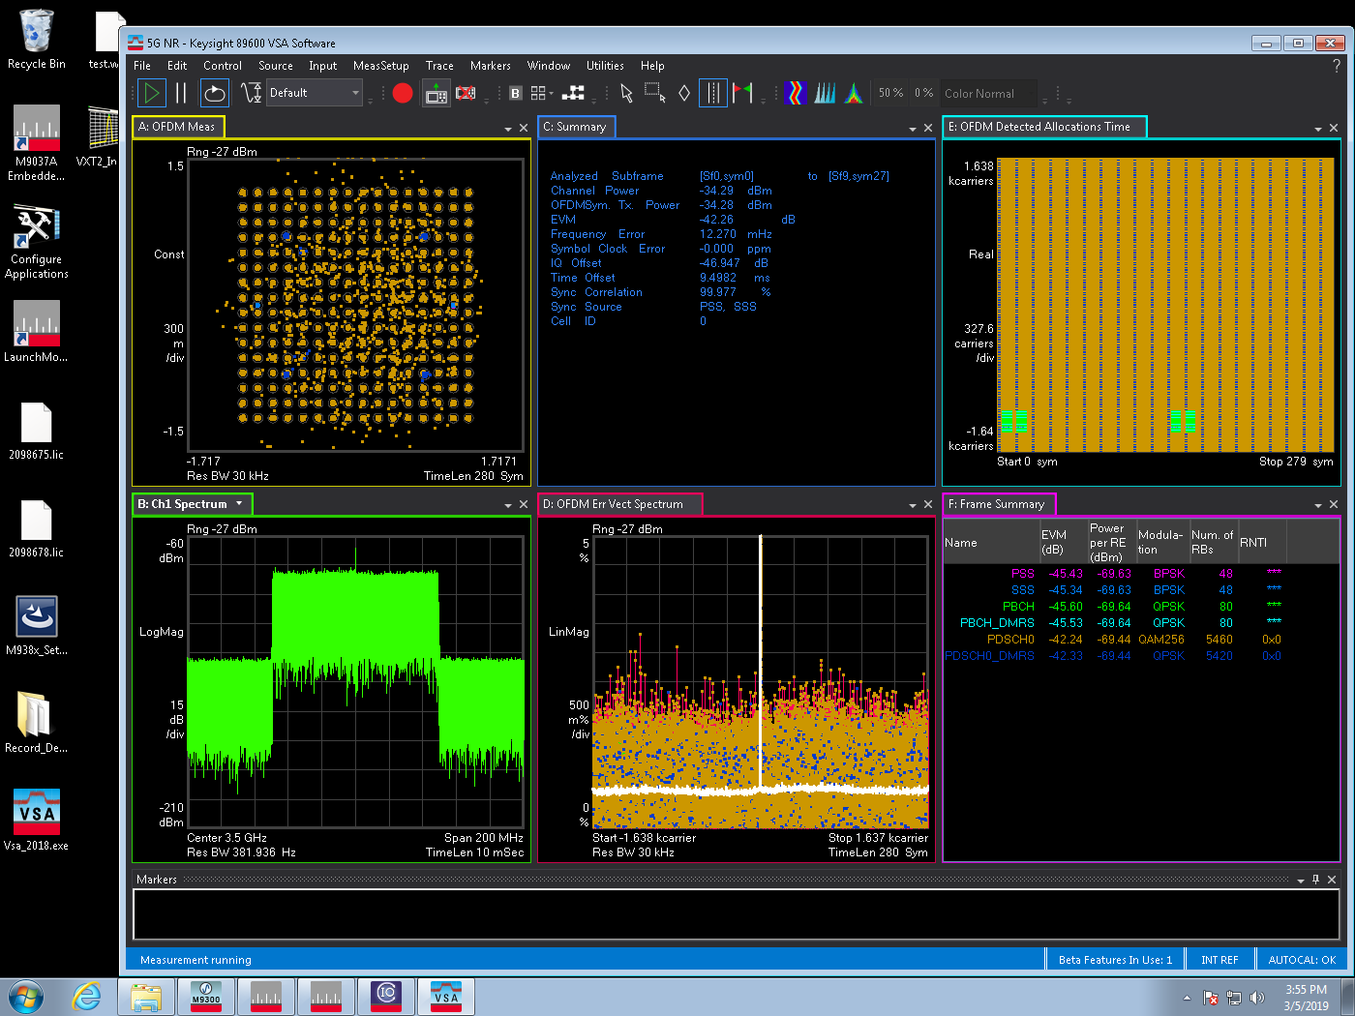
Ideal NR 100M Chamber Pout=10dB
EVM=-42.26
IQ offset=-46.947

Slide 4
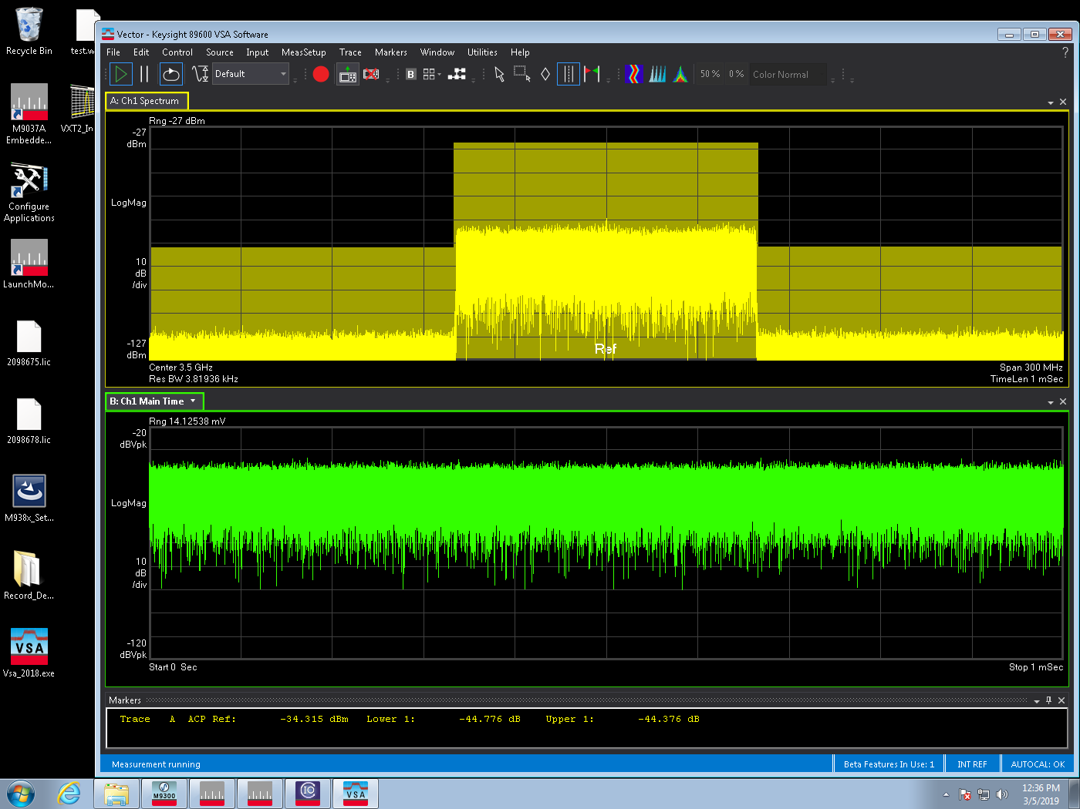
Ideal NR 100M Chamber 10dB ACLR
Lower ACLR=-44.776
Upper ACLR =-43.376

Slide 5
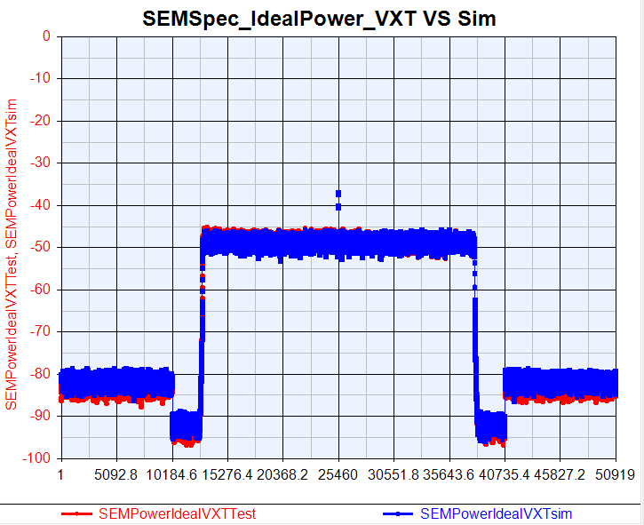
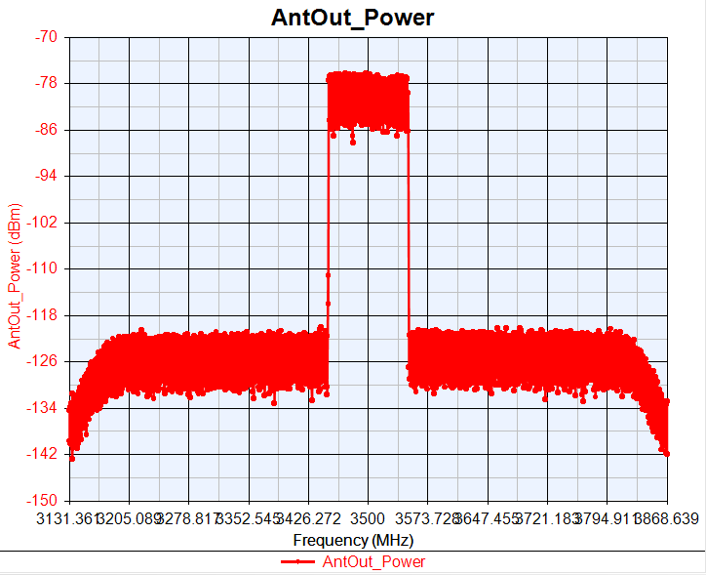
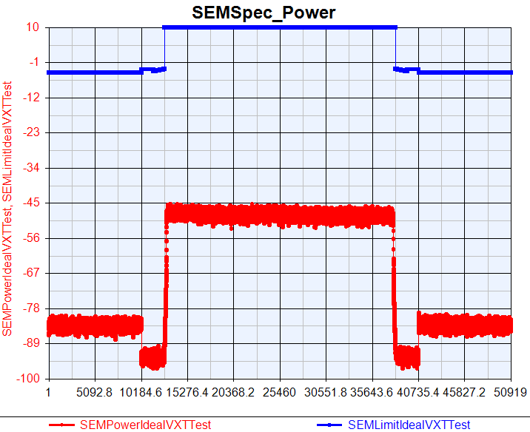
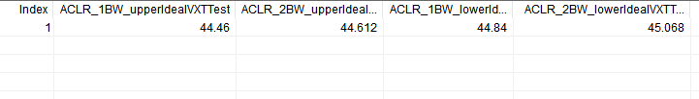
OTA VXT Ideal NR ACLR/SEM

Slide 6
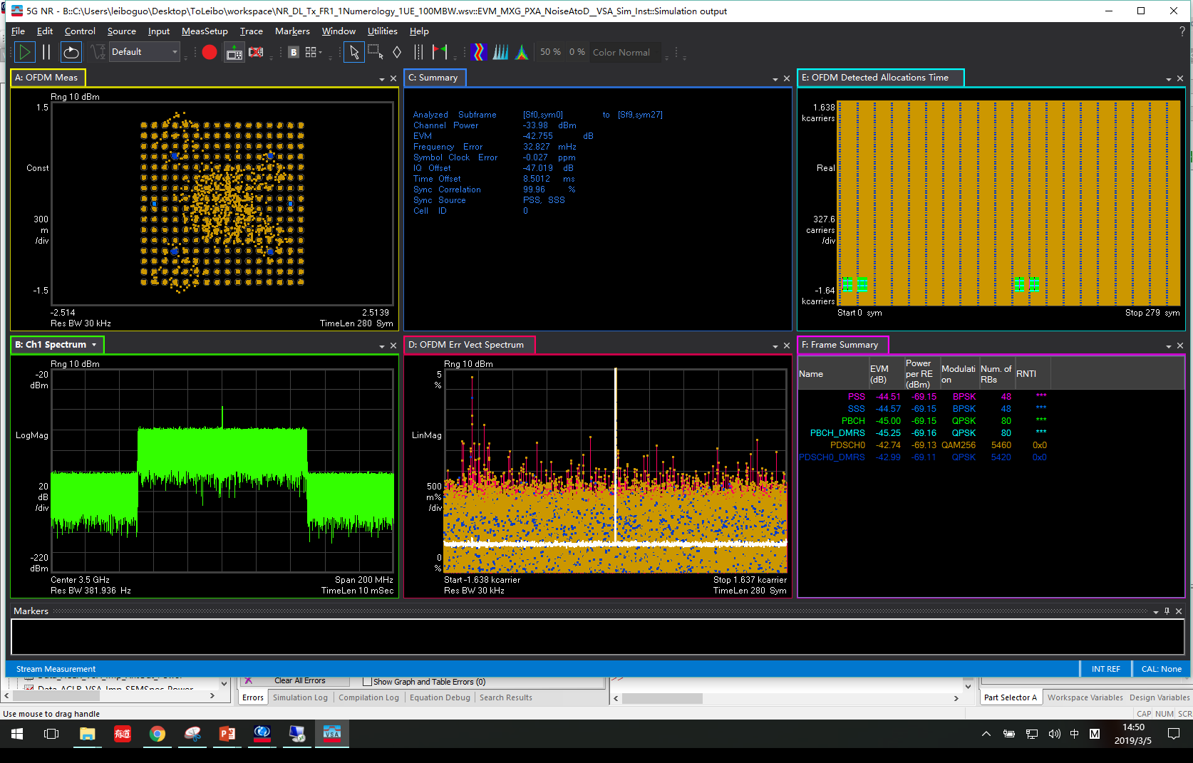
Sim Ideal NR 100M Pout=-34dB
EVM=-42. 76
IQ offset=-47.019

Slide 7
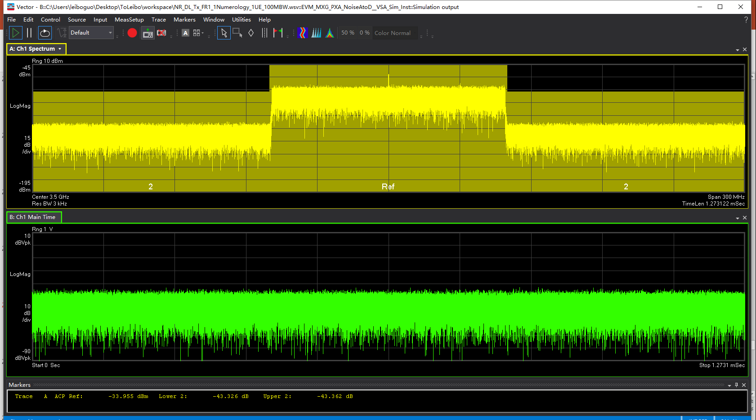
Sim Ideal NR 100M ACLR
Lower ACLR=-43.326
Upper ACLR =-43.362

Slide 8
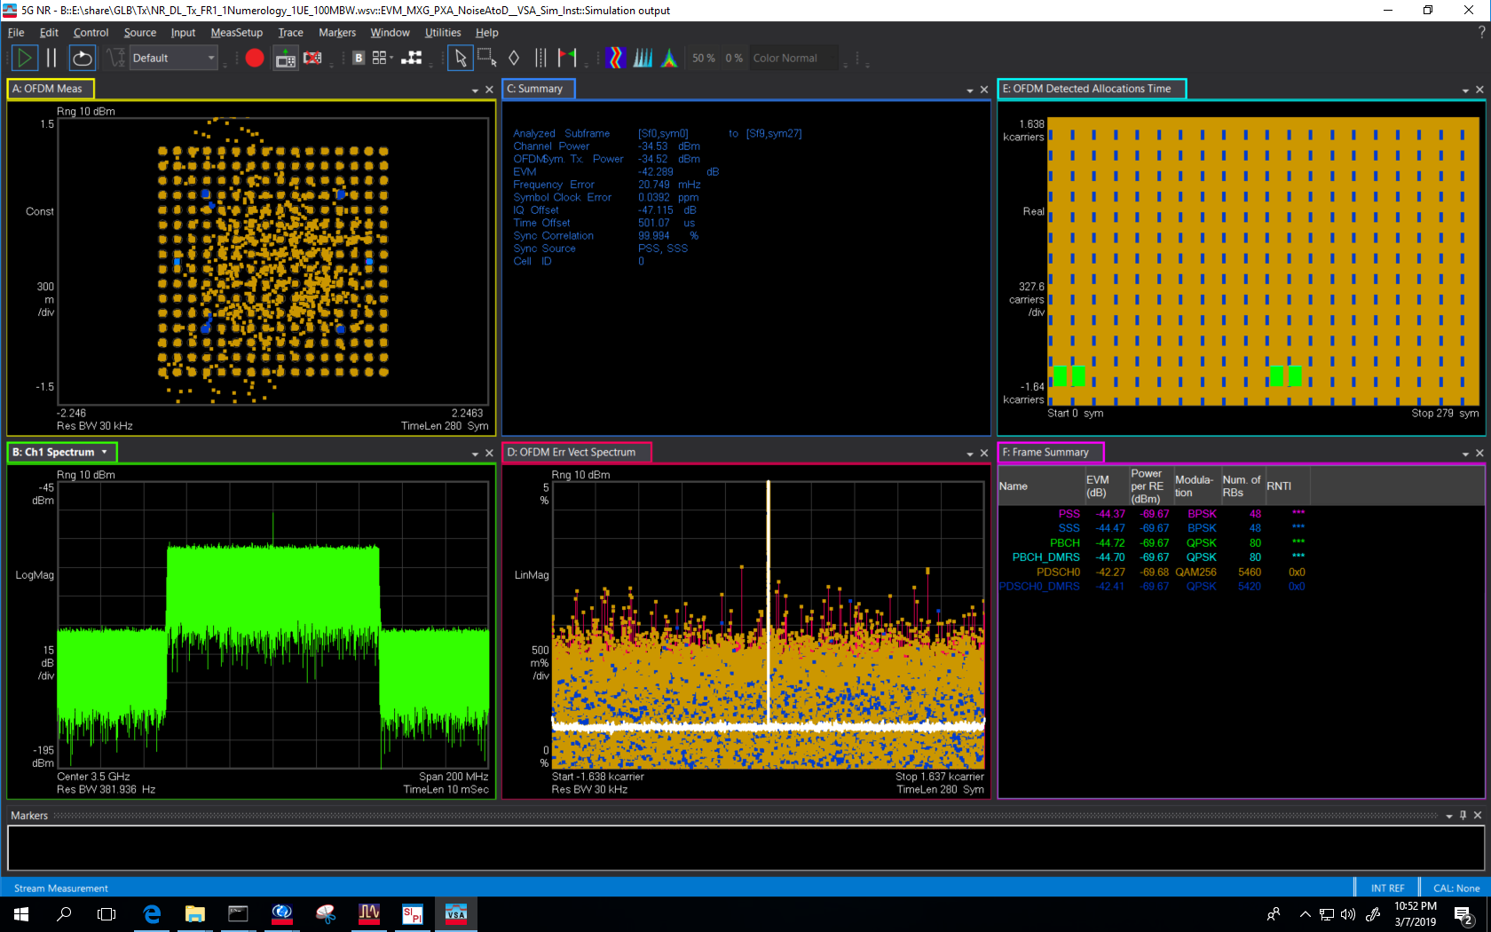
OTA Sim Ideal NR
Pout=10dBm
Gain=0.0022(-53dB)
EVM=-42. 29
IQ offset=-47.115

Slide 9
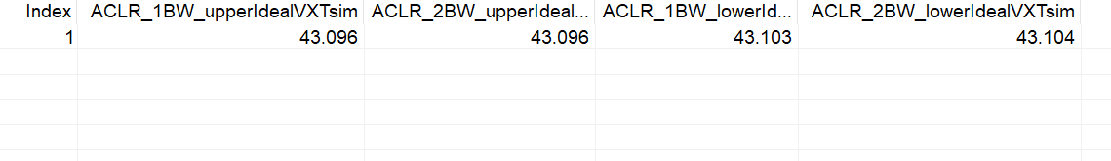
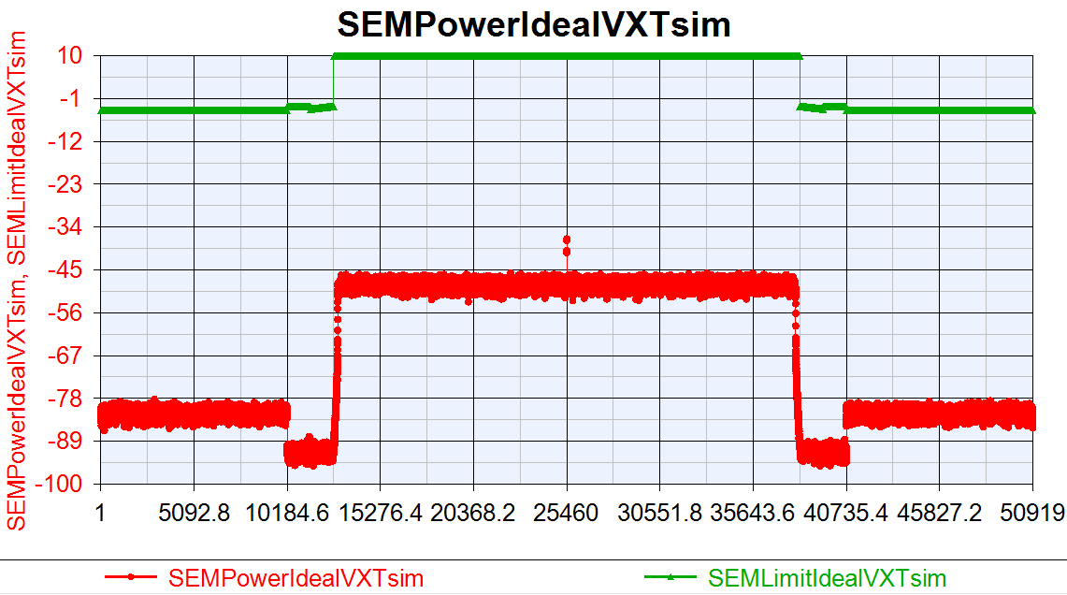
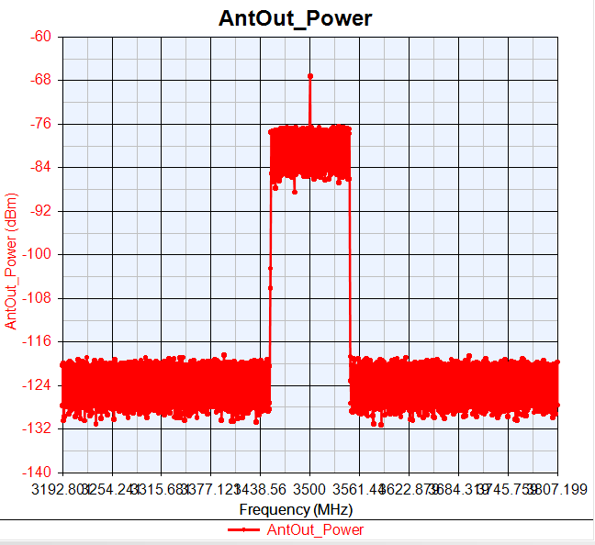
OTA Sim Ideal NR ACLR/SEM

Slide 10
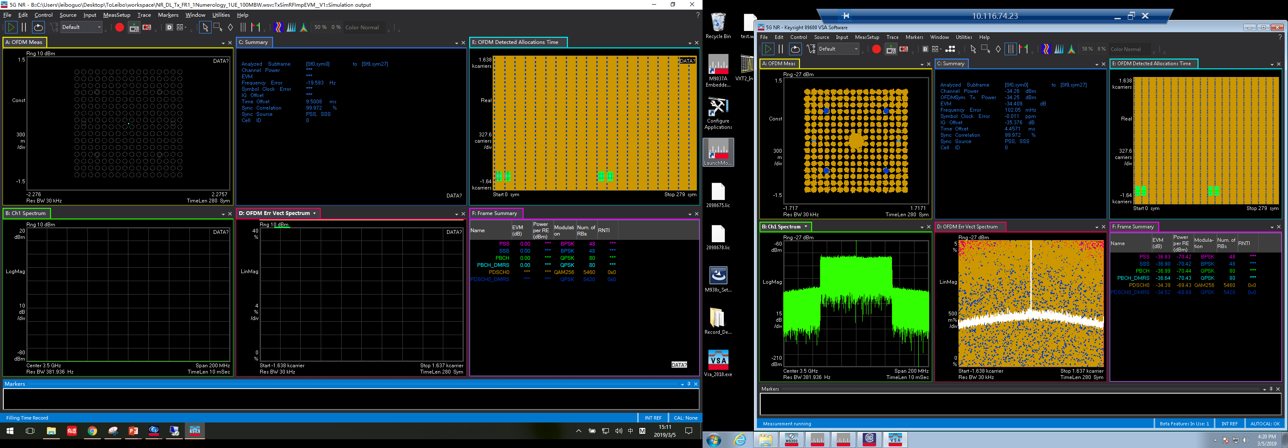
Imp NR 100M Chamber Pout=10dB
IQoffset=0.045
Gain Imb=0.02
PhaseNoise=[100 -88.57 1e3 -97.56 1e4 -111.67]
DAC_Nbits=12
ToIout=20
EVM=-34.409
IQ offset=-35.376

Slide 11
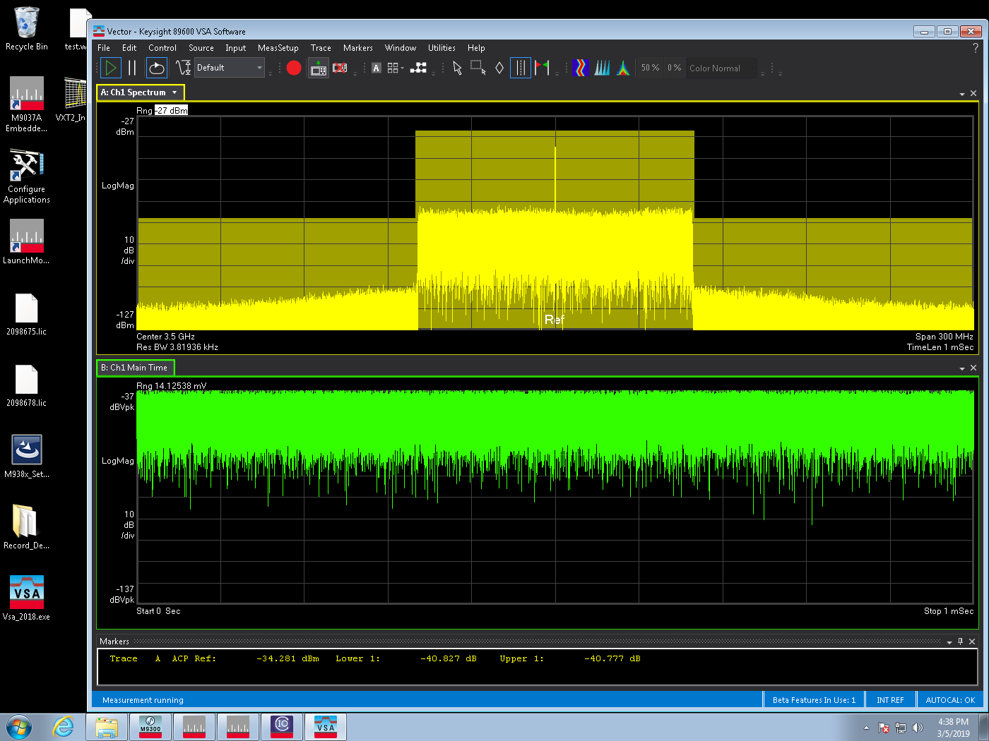
Chamber Imp NR 100M ACLR
Lower ACLR=-40.827
Upper ACLR =-40.777

Slide 12
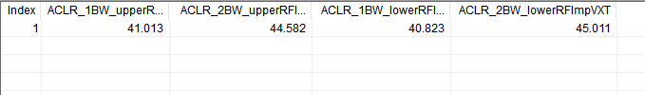
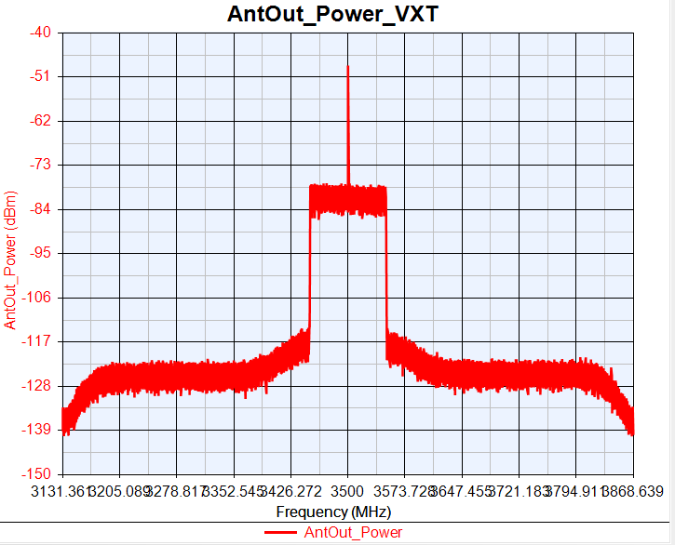
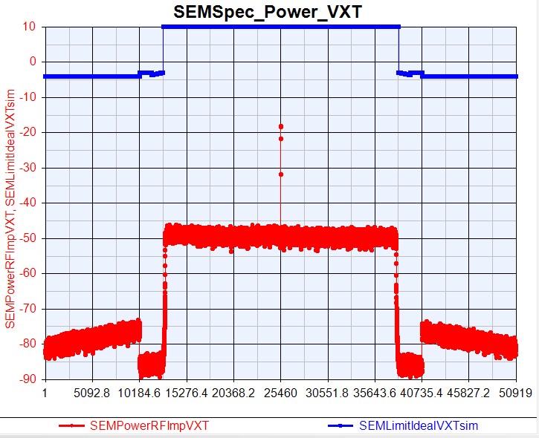
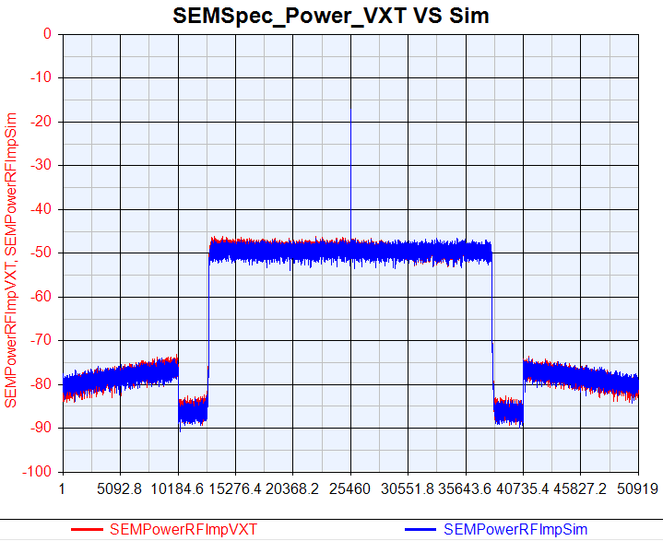

Slide 13
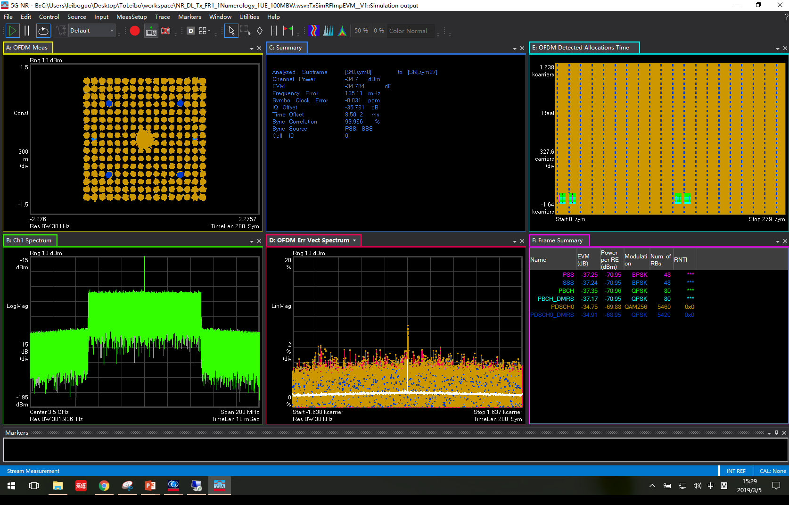
Sim Imp NR 100M Pout=-34dB
IQoffset=0.045
Gain Imb=0.02
PhaseNoise=[100 -88.57 1e3 -97.56 1e4 -111.67]
DAC_Nbits=12
TOIout=20
Density=-158.7
EVM=-34.764
IQ offset=-35.761

Slide 14
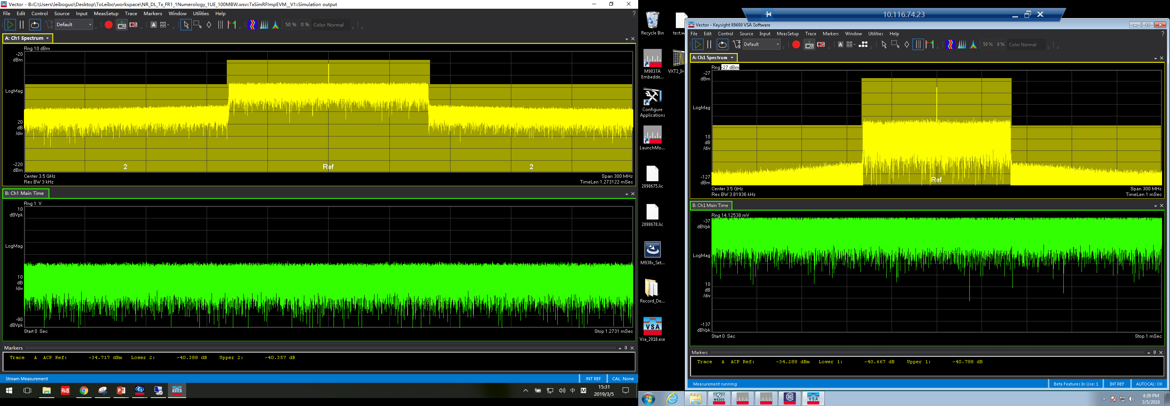
Sim Imp NR 100M ACLR
Lower ACLR=-40.388
Upper ACLR =-40.357

Slide 15
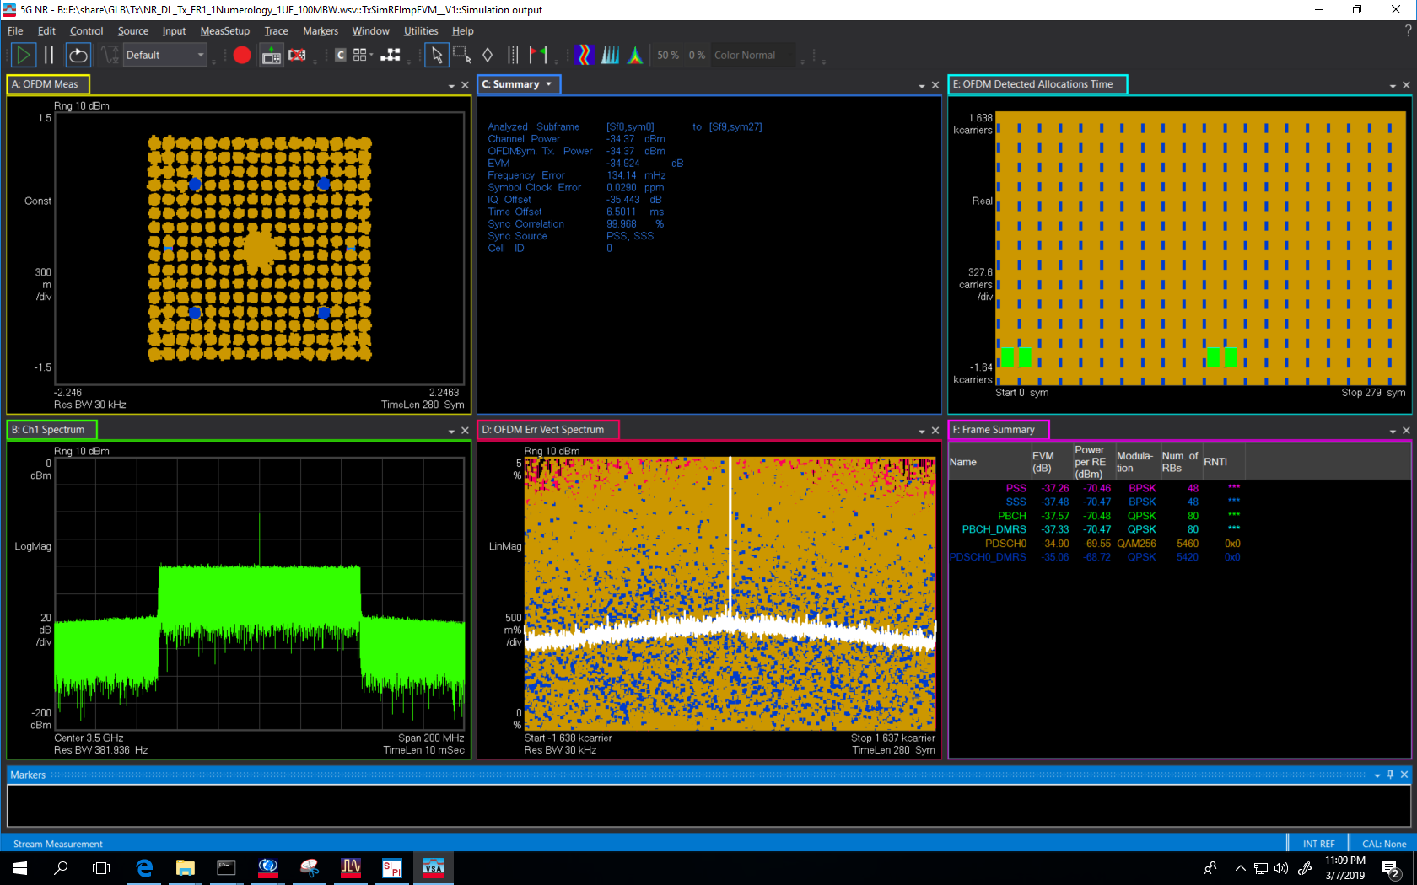
OTA Sim Imp NR
Pout=10dBm
Gain=0.0022(-53dB)
EVM=-34.924
IQ offset=-35.443

Slide 16
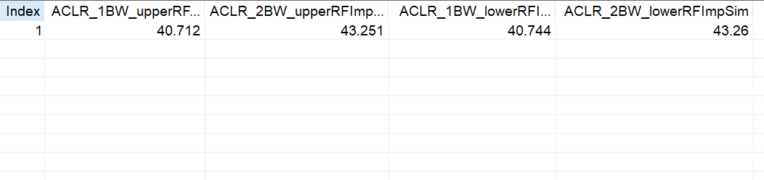
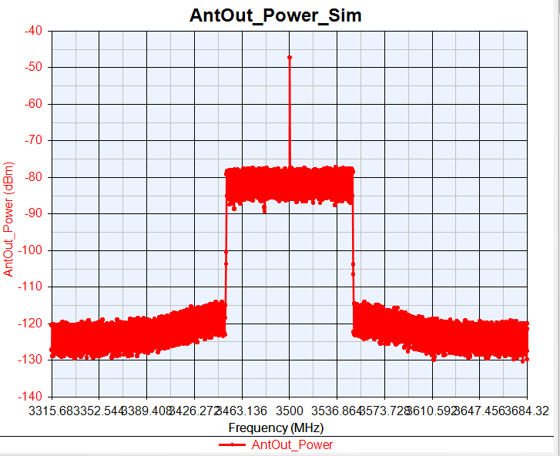
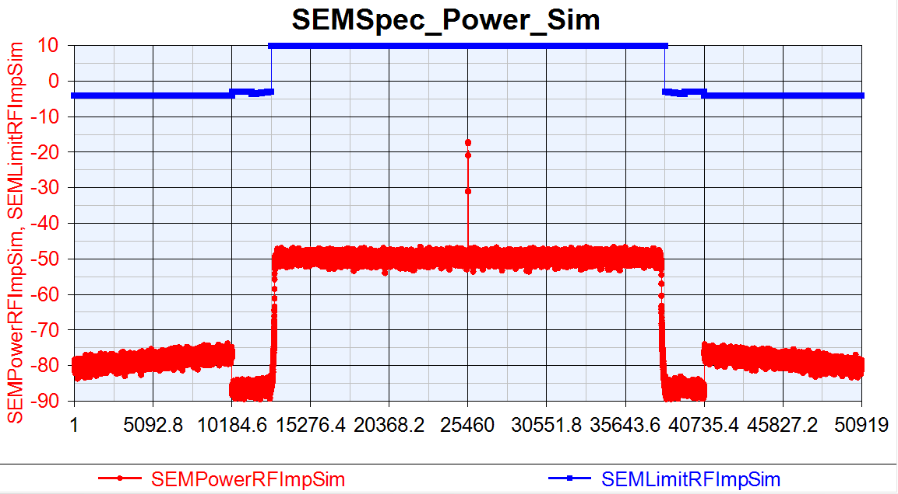
OTA Sim Imp NR ACLR/SEM

